Slide 1
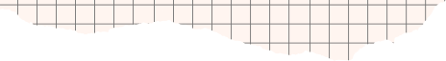



GROUP
PROJECT
By Burak EVREN and Buğra Eren BULGAY

Slide 2



TODAY'S AGENDA
Introduction
Project overview
In Production SS
UML Class Diagram
Use Case Diagram

Slide 3



INTRODUCTION
Our project aims to provide a comprehensive platform for individuals who enjoy home-cooked meals and culinary experts alike. To achieve this objective, we have developed a multifunctional website using modern technology stacks.

Slide 4
PROJECT
OVERVIEW
In this project, we opted to leverage the widely popular React library to cater to our front-end needs. For our back-end, we utilized Python to generate API requests, which fetches data from our database. We relied on PostgreSQL for database management, taking advantage of its simple yet effective database solutions.

Slide 5
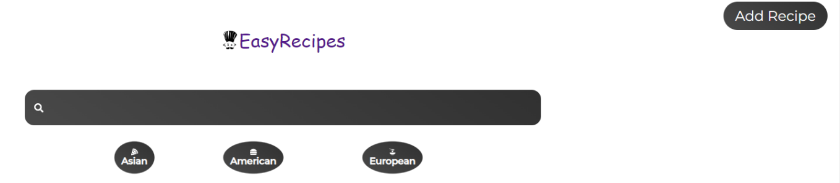
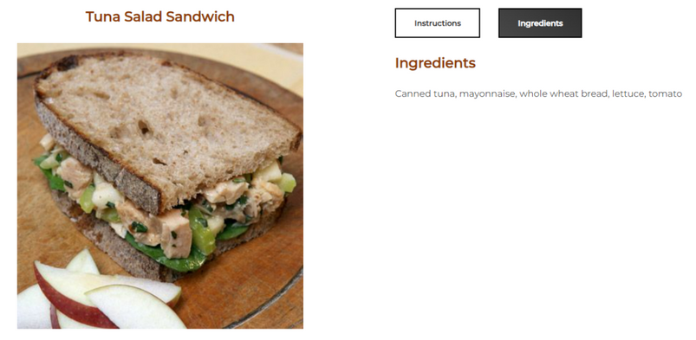
IN PRODUCTION SS
Navigation Bar
Recipe Page

Slide 6
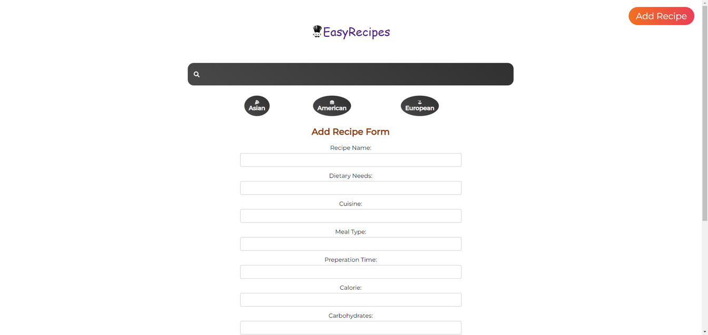

Add Recipe Form

Slide 7
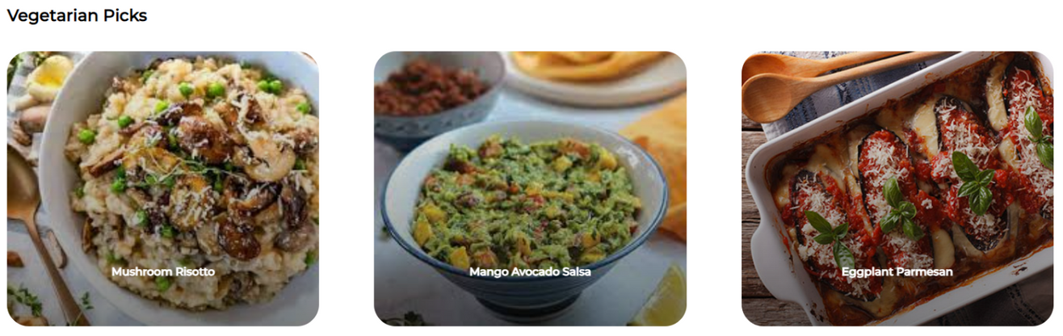
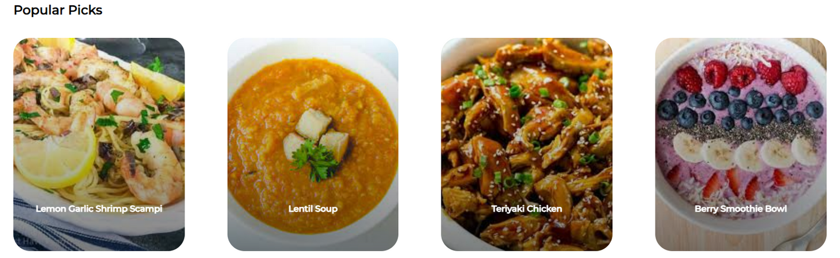
Vegetarian Section
Trending Section

Slide 8

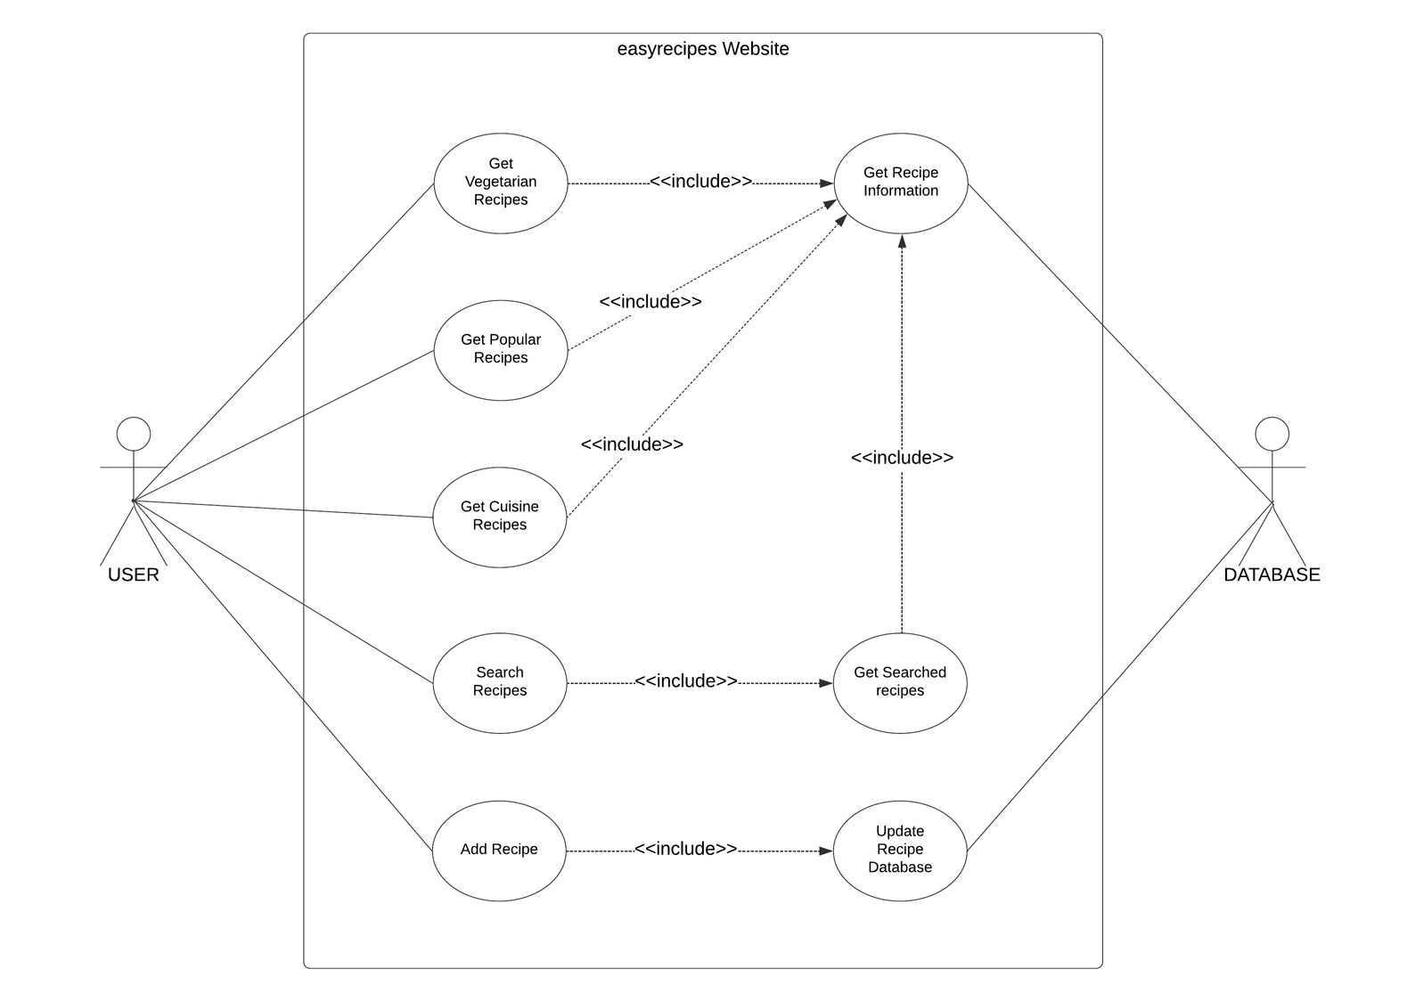
USE CASE DIAGRAM

Slide 9
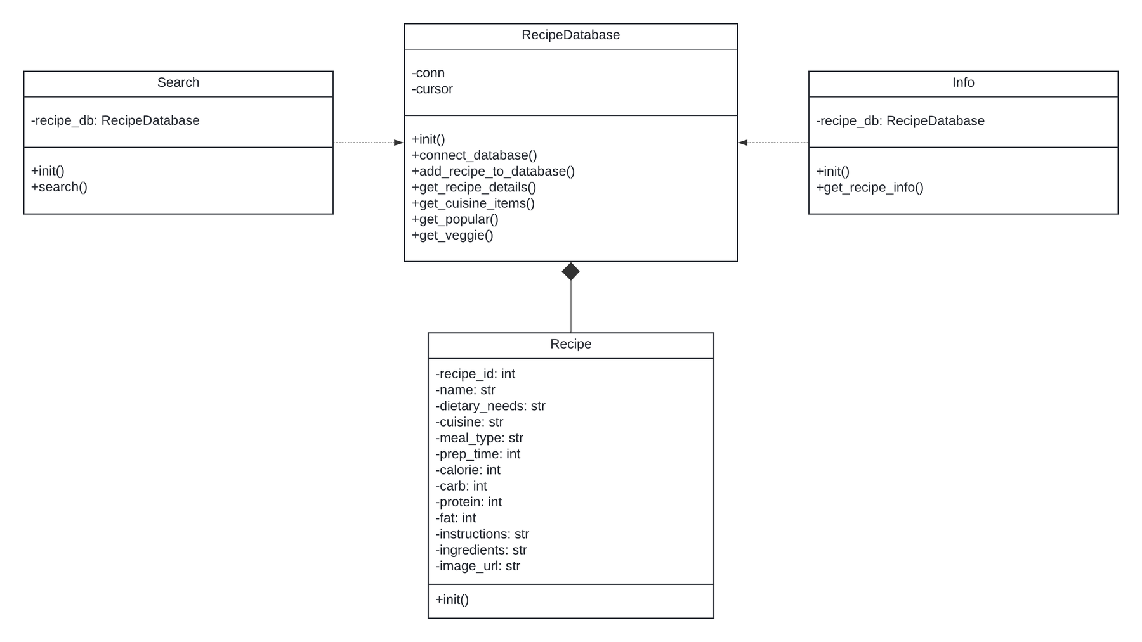
CLASS UML DIAGRAM

Slide 10



THANK YOU!

